Slide 1

“I want to be envolved in the local music scene of my city. Want to discover rare talents and enjoy my time in a nice place”
Goals
Enjoy listening to good music
Find talented musicians
Support local musicians
Get data about upcoming performances of favorite musicians in my city
Frustrations
Not being sure about the acoustics of the place
Not being provided with enough information about the musician and genre of music
Layla
Age:
Education:
Hometown:
Family:
Occupation:
30
Fine Arts and Design
Berlin, Germany
Single
Product Designer
Busy product designer, art and music enthusiast, looking for music events on the weekend, wants enough information about the music, the musician and the place

Slide 2
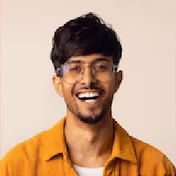
“I want to enjoy my weekend’s evening in small bar with live music. Don’t want to spending too much time searching for it, but want clear information about the event”
Goals
A place to enjoy
Relaxing, meeting friends, socializing
Not very busy or too crowded
App: quick navigations, Ease of booking
Frustrations
Lack of information on:
Time tables of the event
Ways of payment
Price/entry fee
Food menu
Andy
Age:
Education:
Hometown:
Family:
Occupation:
27
IT, Master
Berlin, Germany
Single
Data Scientist
Busy junior Techie, tight time schedule, looking for events on the weekends, wants the app navigation for finding/booking an event to be fast and easy

